Slide 1
BMW i3 CACC Control

Slide 2
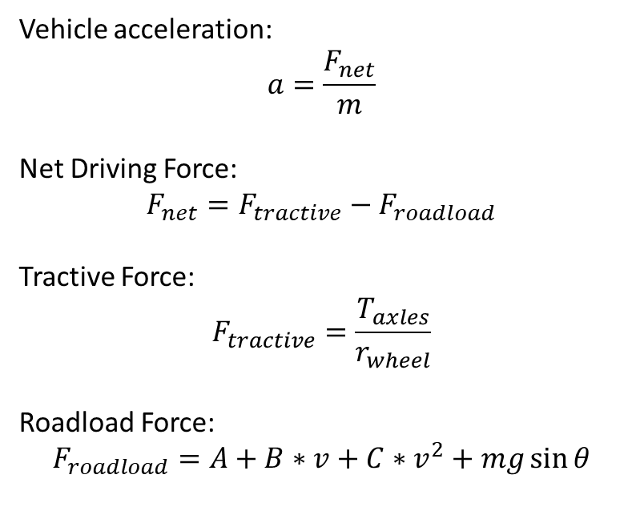
Torque to Acceleration Calculation
Vehicle acceleration:
$$a=\frac{F_{net}}{m}$$
Net Driving Force:
$$F_{net}=F_{tractive}−F_{roadload}$$
Tractive Force:
$$F_{tractive}=\frac{T_{axles}}{r_{wheel}}$$
Roadload Force:
$$F_{roadload}=A+B∗v+C∗v^{2}+mg\sin{θ}$$
Roadload Coefficients:
A= 23.7 lbs (105.46 N)
B= 0.346 lbs/mph (3.444 N/mps)
C= 0.01675 lbs/mph^2 (0.3728 N/mps^2)
Vehicle Mass:
m= 3375 lbs (class weight)
Tire/Wheel Info:
Wheel Size: 175/60 R19
(Bridgestone Ecopia EP600)
Revs per mile: 764 (0.6705 m diam.)
Tire Diam (in): 27.3 (0.6934 m)

Slide 3
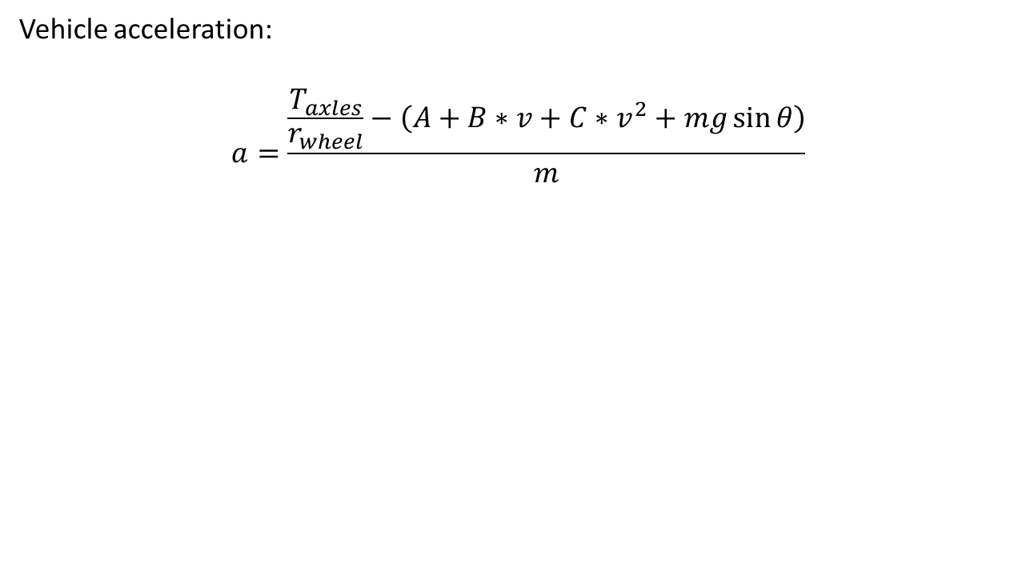
Vehicle Acceleration Equation
Vehicle acceleration:
$$a=\frac{\frac{T_{axles}}{r_{wheel}}−\left(A+B∗v+C∗v^{2}+mg\sin{θ}\right)}{m}$$

Slide 4
Axle Torque and Acceleration vs. Speed
Note: torque/acceleration envelope using accelerator pedal only

Slide 5
Acceleration Envelope: Grade Impact
Note: acceleration envelope using accelerator pedal only

Slide 6
Acceleration Envelope: Mass Impact
Note: acceleration envelope using accelerator pedal only

Slide 7
Torque Response – 100% pedal
~0.3 sec
~1.1 sec

Slide 8
Torque Response – 50% pedal
~0.3 sec
~0.8 sec

Slide 9
On-Road to Dyno Comparison
Fixed-14_BMW_i3_REx_Testing_ref22_NS_F_i3_ACC_mapping 2017-09-07 11-12-35-373000 Log File

